Slide 1
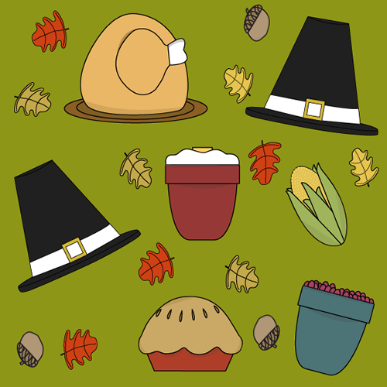
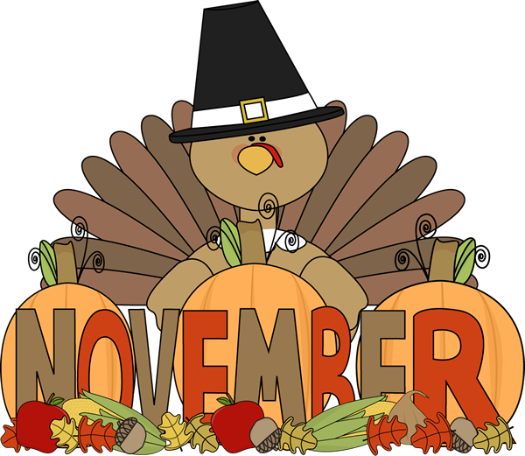
Ms. Xu’s 1st Grade
11th Week Update
（11/5-11/7)
A Message from the Teacher
Dear Families,
Hope you enjoyed the long weekend. We are going to Abbott’s Mill for our first field trip on Wednesday November 5, 2014. We are all excited about this field trip. Here are a few reminders about the field trip:
Please pack your kid’s at least one bottle of water;
If you choose to pack your kid’s for lunch, please pack your kid’s lunch in disposable bags.
If you choose to be the chaperon for this field trip, you can either follow the school bus (Please arrive school at 9:00 am) or you can meet us in Abbott’s Mill around 10:00am. Please click here for driving directions.
The temperature of Wednesday is from 52F to 66F. Please dress your kid according for the field trip.
If you have other questions, please let me know.
Zhongli Xu
Zhongli Xu
zhongli.xu@cr.k12.de.us
Zhonglixu.weebly.com
Looking Ahead at Simpson
11/5 First Grade Field Trip to Abbott’s Mill Nature Center. ( Please remember to pack your kid’s with at least 1 bottle of water)
11/10 Veteran’s Day Assembly
11/11 School Closed for Veteran’s Day.
11/20 Awards Assembly for Chinese Immersion Students 9:45am to 10:35am.
11/26-28 School Closed for Thanksgiving Holiday.
Homework Support in Math and Chinese
There is no homework this week because it is a short and busy week. However, if you would like to kids to continue Chinese reading at home, you can still practice reading Chinese book: “What’s the weather like today?”
For your kids’ performing “What’s the weather like today” video, please click:
Students’ Performance of “What’s the weather like today?”
Enjoy :D
Math
Chinese
Science
SWBAT:
(Student will be able to)
Understand the meaning of “=“ sign
Use different numbers from 0 to 10 to make 10 fluently.
For math addition strategies, please click: http://zhonglixu.weebly.com/math-curriculum-and-goals
Vocabulary:
Equal sign; add; represent; plus; minus; altogether; group; make 10; same;
SWBAT:
(Student will be able to)
Read learn Flowers and Weather book in Chinese and begin to read the book independently
SUPPORTING LINKS, PLEASE CLICK:
Flowers and Weather
SWBAT:
(Student will be able to)
Observe different clothing materials and see how they working with water and sun
Observe the weather and match to wear different kind of clothes
Understand the four season in the year and what weather is like in four season
Science Supporting Vocabulary and other support at home, please click:
http://zhonglixu.weebly.com/weather-and-me

