Slide 1
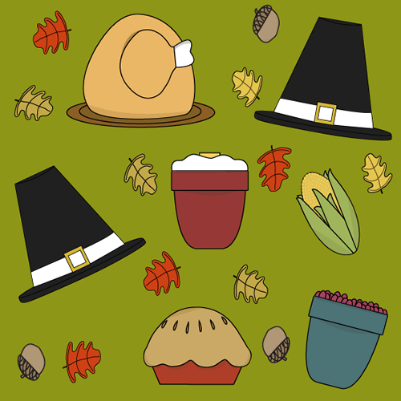
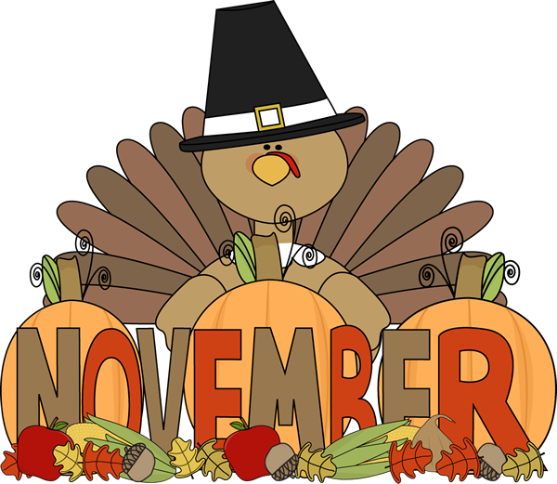
Ms. Xu’s 1st Grade
12th Week Update
（11/10-11/14)
A Message from the Teacher
Dear Families,
Thank you for the support during the field trip. We have had a great time during the field trip. For field trip pictures, please click here.
On Wednesday, your child’s report cards of the first marking period will be sent home. Also, our parent conferences will start from Wednesday to Friday. Please check your scheduled conference time to attend. If your conference is scheduled in after school hours, please take your child with you.
I will be in conference from Wednesday to Friday, so that our students will not start learning new Chinese books. However, they will be having English bridge lesson on important math, science and social studies concepts. It is a good time for bridging the 1st marking period as well as summarize our learning. If you have other questions, please let me know. Mrs. Childers and I am looking forward seeing you during conferences.
Zhongli Xu
Zhongli Xu
zhongli.xu@cr.k12.de.us
Zhonglixu.weebly.com
Looking Ahead at Simpson
11/10 Veteran’s Day Assembly
11/11 School Closed for Veteran’s Day.
11/12-11/15 Parent Conference (Please see your scheduled time and arrive 5 minutes early, thank you :D)
11/20 Awards Assembly for Chinese Immersion Students 9:45am to 10:35am.
11/26-28 School Closed for Thanksgiving Holiday.
Homework Support in Math and Chinese
Please click Homework Support:
Please finish the math worksheets sent home;
Please finish the Chinese worksheet sent home ( Please make sure your children are writing in the right stroke order)
Please practice the Chinese book: Flowers and Weather (Suggested nights are Tuesday and Thursday)
The flash cards of this book in contained in the video.
The Flowers and Weather book will not sent home Monday. Students will Take the book home after the conference.
Math
Chinese
Science
SWBAT:
(Student will be able to)
Understand the meaning of “=“ sign
Use different numbers from 0 to 10 to make 10 fluently.
Fluent fill in fact family houses.
Vocabulary:
Equal sign; add; represent; plus; minus; altogether; group; make 10; same; fact family house; take away; same amount; number line; represent
SWBAT:
(Student will be able to)
Read learn Flowers and Weather book in Chinese and begin to read the book independently
Start learning the book: What Will You Wear Today?
SUPPORTING LINKS, PLEASE CLICK:
Flowers and Weather
SWBAT:
(Student will be able to)
Understand the weather concept
Use the four senses to observe weather
Understand the concept and temperature and dress up according to the temperature
Understand different cloth materials’ water resistance level
Science Supporting Vocabulary and other support at home, please click:
http://zhonglixu.weebly.com/weather-and-me

