Slide 1
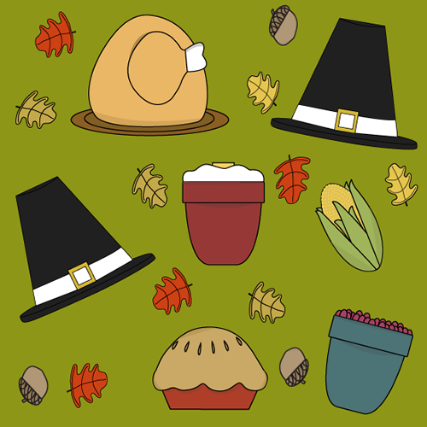
Ms. Xu’s 1st Grade
15th Week Update
（12/1-12/5)
A Message from the Teacher
Dear Families,
Welcome back from Thanksgiving. Hope you all have had a great holiday and enjoyed the break. For 1st marking period award assembly pictures, please click here. If you have more pictures for the award assembly, please forward the pictures to my e-mail address at zhongli.xu@cr.k12.de.us. We will continue learning more about math addition strategies as well as the Chinese book: What Do You Wear Today? Meanwhile, we will start learning social studies unit about Schedules.
Please let me know if you have any other questions.
Zhongli Xu
Zhongli Xu
zhongli.xu@cr.k12.de.us
Zhonglixu.weebly.com
Looking Ahead at Simpson
11/20 Awards Assembly for Chinese Immersion Students 9:45am to 10:35am.
11/24-11/25 Geography Awareness Week.
11/26-28 School Closed for Thanksgiving Holiday.
12/16 Gingerbread House PBS Celebration. ( Please make sure you send in your child’s pride bucks if you see any at home. Students need 100 pride bucks to buy tickets)
Homework Support in Math and Chinese
Please click Homework Support:
Please finish the math worksheets sent home;
Please finish the Chinese worksheet sent home ( Please make sure your children are writing in the right stroke order)
Please practice the Chinese book: Flowers and Weather (Suggested nights are Tuesday and Thursday)
The flash cards of this book in contained in the video.
Math
Chinese
Social Studies
SWBAT:
(Student will be able to)
Understand the meaning of “=“ sign.
Use different numbers from 0 to 10 to make 10 fluently.
Fluent fill in fact family houses.
Vocabulary:
Equal sign; add; represent; plus; minus; altogether; group; make 10; same; fact family house; take away; same amount; number line; represent
SWBAT:
(Student will be able to)
Read learn Flowers and Weather book in Chinese and begin to read the book independently.
Start learning the book: What Do You Wear Today?
SUPPORTING LINKS, PLEASE CLICK:
Flowers and Weather
What Do You Wear Today?
Starting from this week, we will begin Social Studies Unit on Schedules. Students will be learning what is schedule, why schedule is important and how to read a schedule.
SWBAT:
(Student will be able to)
Understand what is schedule.
Get the basic concept of scheduling.
Understand school’s class schedule in Chinese side.

