Slide 1
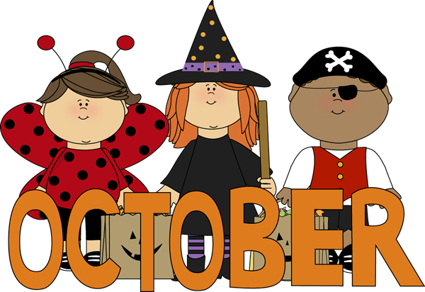
Ms. Xu’s 1st Grade
6th Week Update
（9/29-10/3)
A Message from the Teacher
Dear Families,
Welcome back! Thanks for your support of the Rider Pride Party as well as for the first PBS celebration. Our kids had lots of FUN and once again, we appreciate what you have done. Click here for pictures!
The Dance-A-Thon envelopes have been sent home. They need to returned back to school by October 1st. This is the major fundraise event of the school year. Please support :D
Also, homework will be sent on Monday and please return on Friday. Please let me know if you have any other questions about homework. Have a great week!
Zhongli Xu
Zhongli Xu
zhongli.xu@cr.k12.de.us
Zhonglixu.weebly.com
Looking Ahead at Simpson
10/1 Dance-A-Thon envelopes need to be returned. (Please note that this is the biggest fundraise event through the whole year. WE need your support!)
10/1 Family Literacy Night 6:00 to 8:00 pm.
10/8 Picture Day.
10/14“Good Neighbor” Community Breakfast 8:00am to 9:00am.
Homework Support in Math and Chinese
Please Click: Homework Support
Two pieces of math worksheets.
One piece of Chinese worksheet.
Practice Chinese flash card vocabulary.
Practice reading Chinese Green Book 10: What Day Is it Today?
Note: When I send home worksheets, I will double-sided copy the math worksheets. Also, the Green Book 10 is online when you click PDF. We do not have enough books to send home for every student. So you may practice reading online. Thanks for understanding.
Math
Chinese
Science
SWBAT:
(Student will be able to)
Represent any numbers within 30 using tens and ones.
Use tables, charts and graphs to organize data.
Review and use what we have learned in first unit and apply in different situations.
VOCABULARY:
Tens; ones; tables; tallies; charts; represent; data; more; less; model; same; least; greatest; data; compare;
amount.
SWBAT:
(Student will be able to)
Read Chinese Readers Green Book 10: What Day Is It Today?
Read the Chinese book “Little Red Hen”
SUPPORTING LINKS, PLEASE CLICK:
What Day Is It Today? Green Book 10
“Little Red Hen”
(You can click on the words to pronounce each vocabulary)
SWBAT:
(Student will be able to)
This week, we will start the science unit “Weather and Me”:
Observe the weather and respond what weather is like today.
Dress up appropriately according to the weather.
Use four senses to observe the weather: see, smell, touch and hear.

